Slide 1
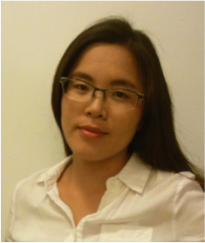
Eskişehir Osmangazi University
Translational Medicine Researchs
(ESOGÜ – TATUM)
Researcher Conferences
Engineering Biomimetic Tissue Constructs for Regenerative Medicine and Organs-on-a-chip Applications
Su Ryon Shin
Ph.D., Assistant Professor and Principal Investigator
Brigham and Women's Hospital
Harvard Medical School, Cambridge, Boston, USA
16 Aralık 2020, Saat 20.00
Link:
https://zoom.us/j/97459079825?pwd=TDlvMVZNRlo0amJVck5MN3FOVXpxZz09
Meeting ID: 974 5907 9825
Passcode: 705465

